Slide 1
DREAMWEAVER
Manage Sites / FTP (initial setup)
Create a New Trailer or Catalog Page From Template
Update the “_allShows.html” Page
Change Vimeo Video Clip Address
Replace Header or Poster Image
Upload New Files To The Server

Slide 2
DREAMWEAVER
! SUGGEST BACKUP OF SITE BEFORE UPDATING
! ANY CHANGES TO A DIV WILL CHANGE ALL PAGES USING THAT DIV STYLE
THUMBNAIL IMAGE SIZES
170 px wide x 240 px height
File Size of 10k to 20k appx
! CATALOG THUMBNAIL IMAGE SIZE FOR THE “DEFAULT.HTML” PAGE 400 px wide x 600 px height (IMPORTANT TO MAINTAIN THIS)
HEADER IMAGE SIZES
1024 px wide x 320 px height – 72 DPI
File Size of 70k to 130k appx
TO PASTE NEW TEXT INTO WEBPAGE: RT click -- > Paste Special --> Paste as text Only

Slide 3
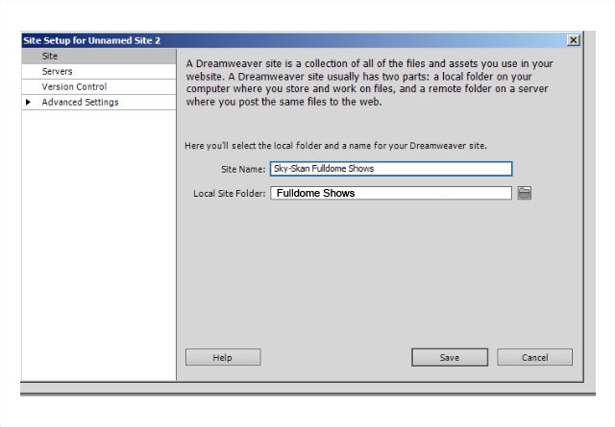
ADD A NEW SITE (LOCAL)
Site → Manage Sites → New Site
Add your site name
Add the website folder that’s on your computer (Local)
Save

Slide 4
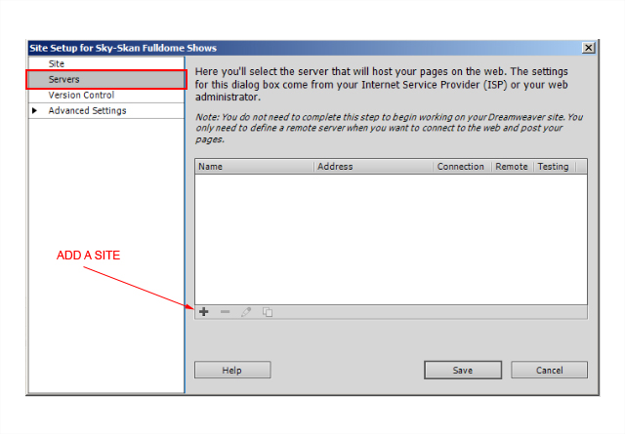
ADD A NEW SITE (REMOTE)
Servers → Hit the “+” button to add a website

Slide 5
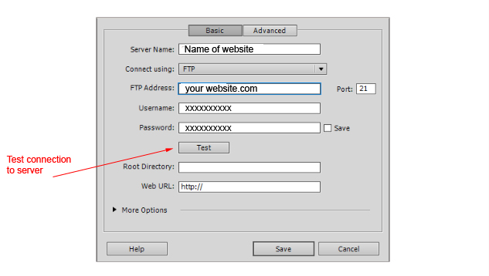
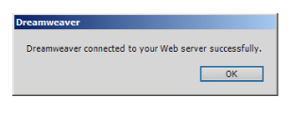
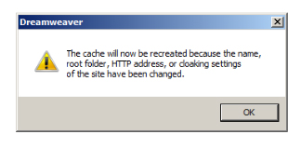
ADD A NEW SITE (FTP)
Server name – FTP address – user name – Password – Test Connection - Save
SERVER CONNECTION VERIFIED
WEBSITE CACHE CREATED

Slide 6
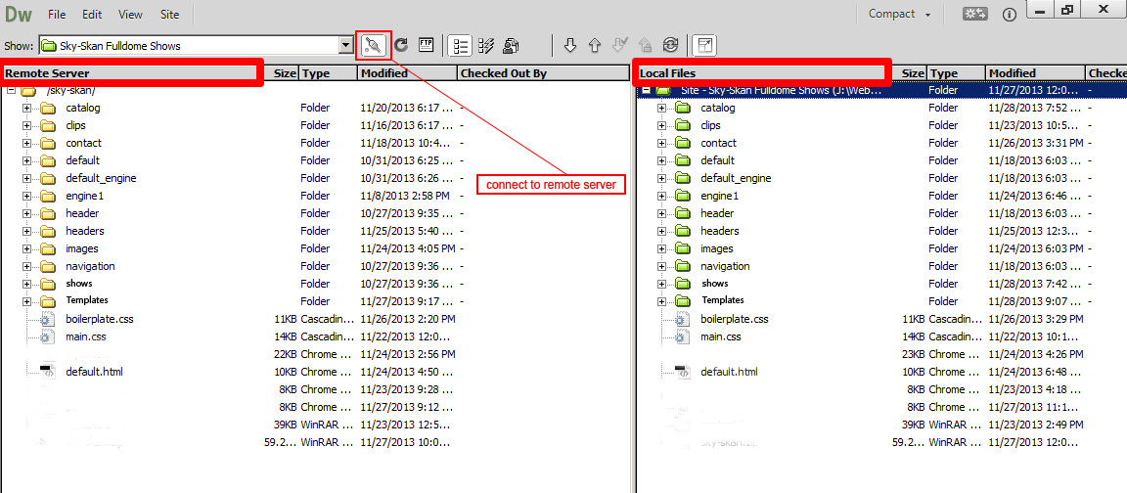
Local / Remote View

Slide 7
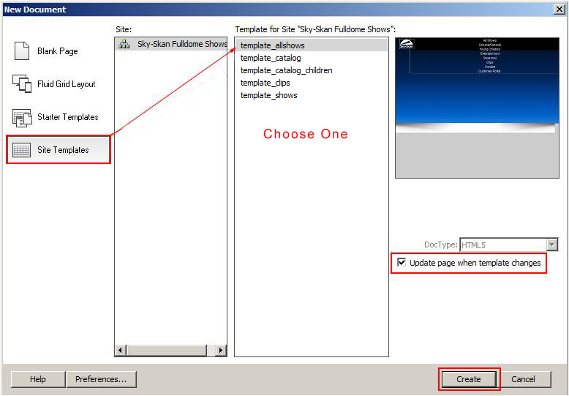
CREATE A NEW PAGE FROM A TEMPLATE
File → New → Site Templates
Choose one of the five templates
Make sure that “Update page when template changes” is checked
Click on the “Create” button
Save as your new page in it’s specific directory (trailers or catalog)
Replace header or poster image
Save

Slide 8
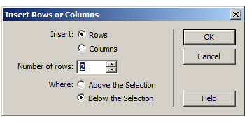
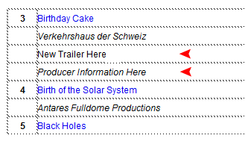
ADD A NEW LINK TO "_ALLSHOWS.HTML" PAGE
Open “_allShows.html" page
Modify --> Table --> Insert Rows or Columns
Insert Rows - Number of rows = 2
Type in new page title and producer info

Slide 9
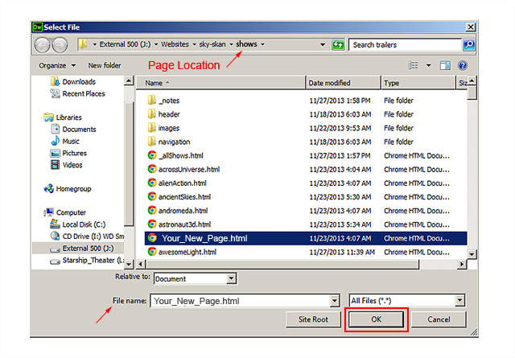
ADD A NEW LINK – VIEW FILES
Highlight page title --> RT Click - -> Make Link --> select new page
Font color will change to blue after linking sucessfully to a page.
F-12 to bring up browser & check link

Slide 10
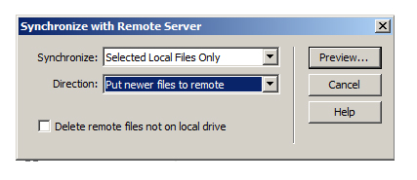
UPLOAD CHANGES TO LIVE WEBSITE - SYNCHRONIZE
Rt click on newly created files --> Synchronize -->
Selected Local Files Only
Put Newer Files To Remote <-- USE THIS OPTION ONLY
Click on "Preview“
Check the live website to verify updates - May need to refresh page a few times or CLEAR YOUR BROWSER CACHE – (delete temporary internet files)

Slide 11
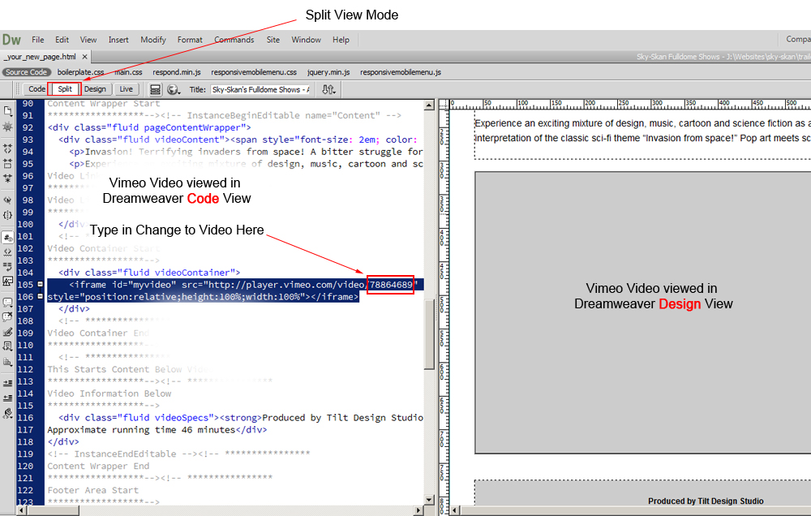
CHANGE VIMEO VIDEO CLIP ADDRESS

Slide 12
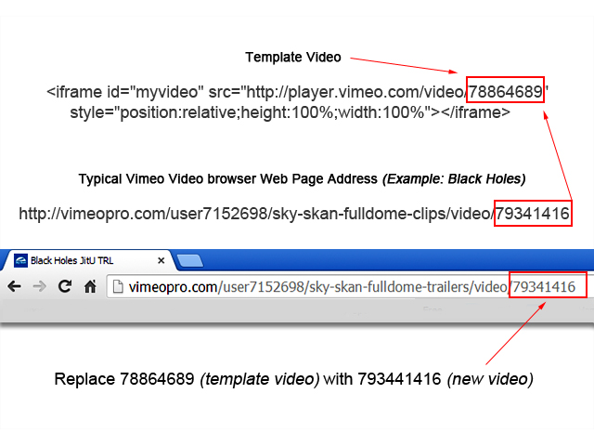
CHANGE VIMEO VIDEO CLIP ADDRESS

Slide 13
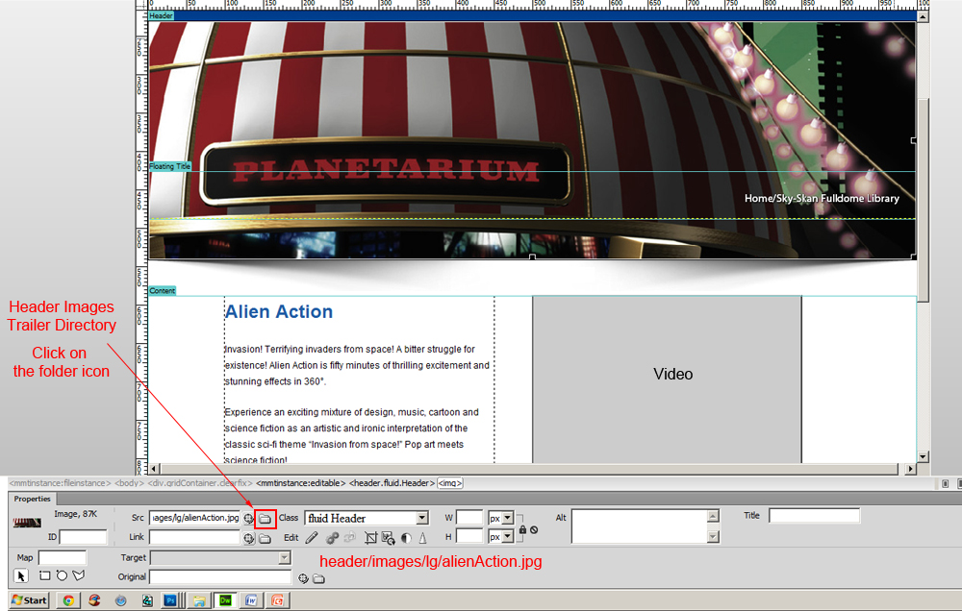
HEADER IMAGE REPLACE

Slide 14
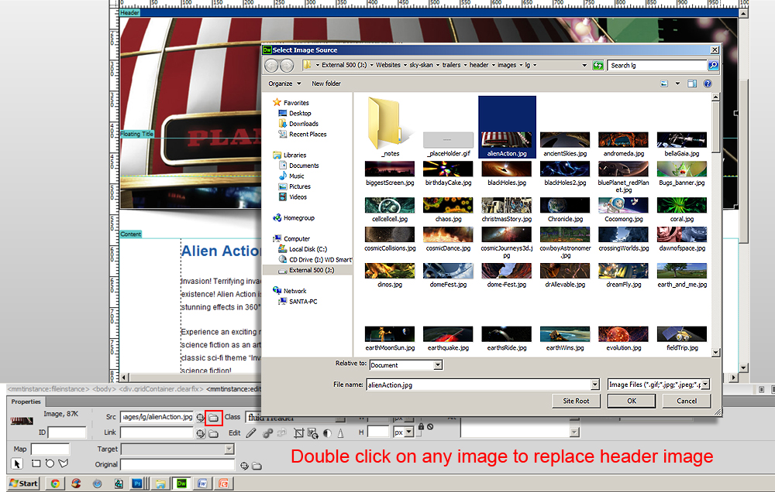
HEADER IMAGE REPLACE

Slide 15
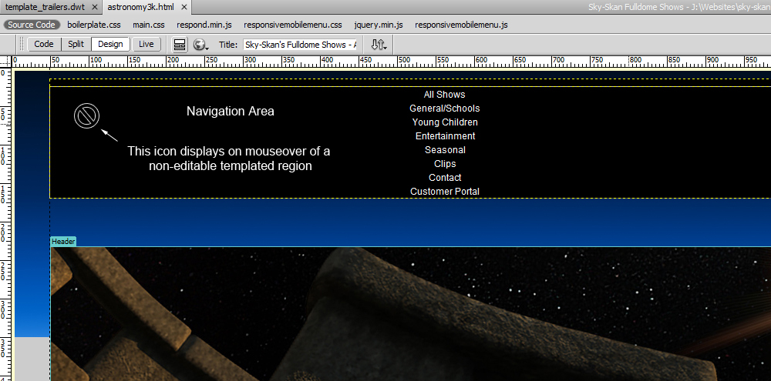
TEMPLATES UPDATE NAVIGATION and FOOTER
Navigation and footer areas only are templated.

Slide 16
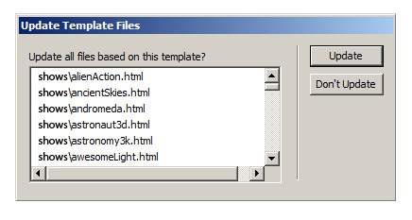
TEMPLATES UPDATE NAVIGATION and FOOTER
When saving changes to a template, File → Save,
Dreamweaver asks if you want to update all files that were created from it.
NOTES:
“template_shows.dwt” - updates126 “shows” pages
“template_catalog.dwt” - updates 7 “catalog” pages
“template_catalog_children.dwt” - updates1 page (random header image rotator)
“template_clips.dwt” - updates 1 page (unique page layout)
“template_allshows.dwt” - updates 4 “all shows” links pages
There are Five pages are not attached to templates:
index.php & confirmation.html (in the “contact” directory)
thinktank.html (in the “shows” directory)
domeXF.html (in the “domexf” directory)
default.html
These pages have unique layouts and will probably never need to be duplicated but site wide changes to the footer and navigation areas then will have to be done to these pages individually.

